Slide 1
Thomas Edison
The Greatest Victorian
By Lewis

Slide 2
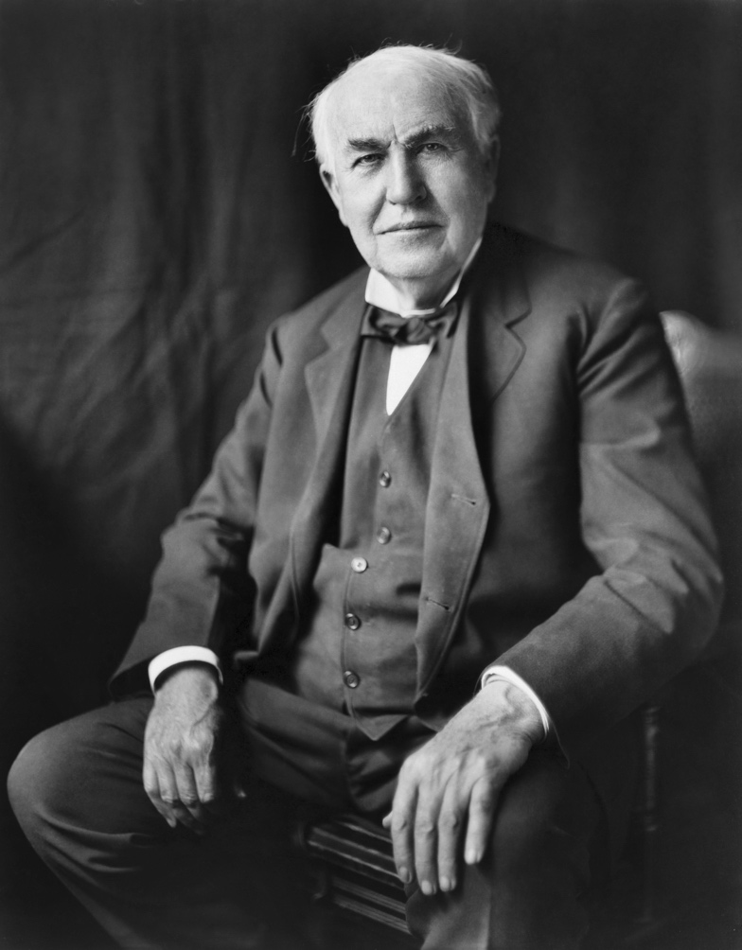
Thomas Edison
Born: United States of America.
The youngest of 7 children.
Born in 1847, he died when he was 84 years old.
He set up his first laboratory in his parent’s basement at the age of 10!
He was partially deaf. He said this helped him to concentrate.
He is so great because he has over 1000 inventions to his name, many have changed the world forever and still influence the way we live today.

Slide 3
Main Inventions
The phonograph – playing the first recorded sound, he even used foil to improved the sound!
Motion pictures – he helped to make images in television and cinemas.
He contributed to X-ray technology and storage batteries.
But I think his greatest invention was…...

Slide 4
The light bulb used in our homes today!
He invented this light bulb in 1878.
He also invented safety fuses and on/off switches for light sockets.
Light bulbs are used so much in our daily lives.

Slide 5
The End
Thank you Owls for listening!

