Slide 1
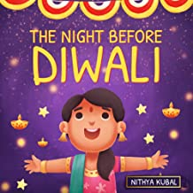
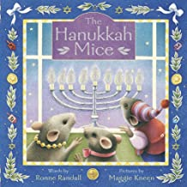
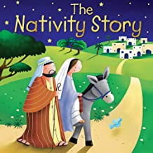
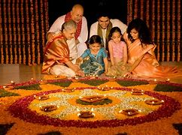
Celebrations
How and why do people celebrate different festivals?
Useful books
Sticky Knowledge
What is Diwali?
Diwali is a very important festival celebrated mainly by Hindus and Sikhs, but can be celebrated by other religions too.
It is sometimes called the festival of lights.
This year it is celebrated on 12.11.23
How is Hanukkah celebrated?
A menorah is a special type of candle holder
It is lit by Jewish people to celebrate Hanukkah
One candle is lit for each day of the festival.
New vocabulary
word | definition
Festival | A time or event that is celebrated
Religion | A set of beliefs
Diwali | The Hindu and Sikh festival of light
Hanukkah | The Jewish festival of light
Christmas | A Christian festival celebrating the birth of Jesus
How do Christians celebrate Christmas?
As part of Christmas celebrations some Christians go to church
Church services often include a retelling of the birth of Jesus.

Slide 2
Physical Development
In our PE sessions this term we will be learning basic gymnastic skills on Mondays, and focusing on multiskills with Mr Shipley on Thursdays. We will be doing daily “funky fingers” activities to build up our fine motor control skills.
Mathematical Development
In Maths we are going to be comparing the numbers 1,2,3 and exploring circles and triangles. We will then move on to explore the numbers 4 and 5 and different shapes with 4 sides. We will also be finding 1 more / 1 less within numbers to 5 and exploring the concept of time through our daily routine.
Understanding the World
We will be learning about different festivals and celebrations including Remembrance Day, Diwali, Christmas and Hannukah. We will learn about the groups of people who celebrate them and how they celebrate.
We will learn about the historical figure Guy Fawkes and discuss why he was an important person from the past.
Communication & Language, Reading and Writing
Through daily story time, we will develop our ‘book talk’ skills. We will practise asking and answering questions about stories. We will continue with our daily phonic teaching with a focus on blending and segmenting the new sounds we have learnt. We will be writing simple words and sentences using our phonic knowledge, and we will listen to a variety of stories linked to our Celebration topic.
PSED
In PSED we follow the Jigsaw scheme, this term our theme is celebrating difference.
Expressive Arts and Design
We will be creating different effects using a variety of materials. We will be making clay divas, pastel poppies, junk model rockets and Christmas crafts. We will be learning lots of songs for our Nativity.
Special events:
7.11.22 – Dentist visit to talk about looking after our teeth
10.11.22 – Disco
11.11.22 – Remembrance Day
14.11.22 – Odd socks day and Anti bullying week
18.11.22- Children in Need
2.12.22 – Extravaganza!
6.12 / 7.12 - EYFS Nativity
7.12.22 – Trip to Baptist church for live Nativity
15.12.22 – Christmas lunch and jumper day
16.12.22 – Christmas service
RE
Our RE question is Why do Christians perform Nativity plays at Christmas? Our whole school value is love.

Slide 3
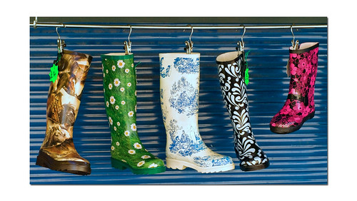
Can you help us?
We would love to start our weekly in school library sessions – are you free for an hour per week? Please let us know if you are able.
We are (weather permitting) hoping to go for some local area welly walks – are you free on a Monday afternoon between 2-2:45pm to come with us? We need 3 parent volunteers per class….(Please see a sign up post on Seesaw)
If you are able to help please see Mrs Savage to organise a DBS check, thank you!

